Slide 1

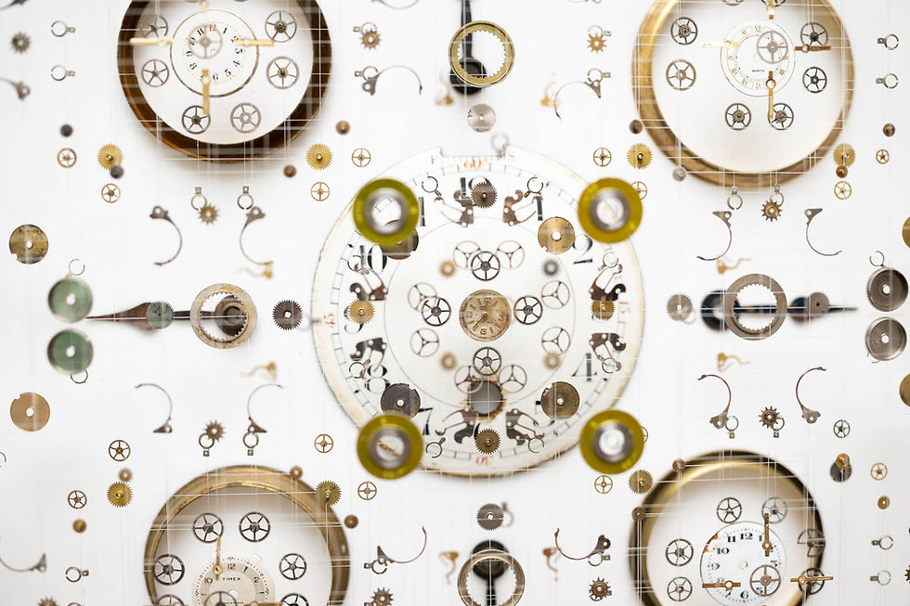

Ephemeral Time
Seeing Sound, Hearing Time
A Synesthetic Inquiry into the Subjective Experience of Time
Presentation Date: November 9, 2025
Presenter: [Name]
ID: [ID]

Slide 2









The Core Philosophy: Beyond Numbers
"Time flows equally, but the traces left behind differ based on our actions and attention."
Conventional vs. Synesthetic Time Perception
Our Question
How can we perceive time without numerical clocks?
Numerical Time
Synesthetic Time
Our Answer
Objective measurement, linear progression, quantifiable moments
Subjective experience, sensory融合, qualitative perception
Through a synesthetic experience where senses merge
Ephemeral Time: Seeing Sound, Hearing Time | 2/10

Slide 3









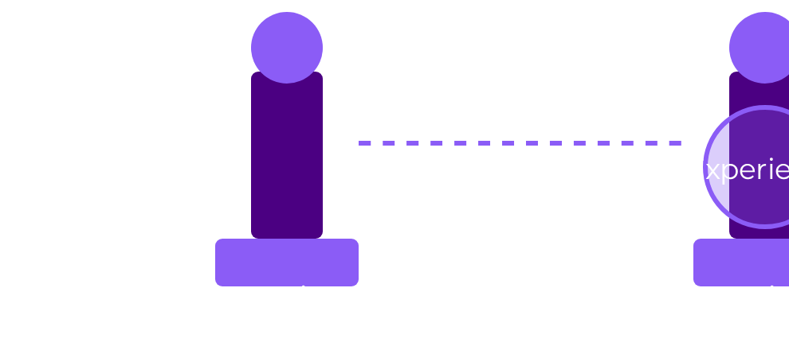



Criterion 1: Concept Elegance - The Three Pillars
Conceptual Elegance
Hearing Time
Seeing Structure
Feeling Focus
The project's conceptual elegance is built upon three interconnected pillars, each designed to offer a unique synesthetic pathway to experiencing time.
Sonification
Cymatics
Fluid as Attention
Ambient audio within the installation subtly brightens as the hour progresses, providing an auditory cue for the passage of time without numerical indicators.
At precise 15-minute intervals, chime events occur and are translated into visual sound waves through Cymatics, creating discernible patterns that allow users to "see" the structure of time.
User interaction directly influences a dynamic "attention reservoir" represented by fluid dynamics. Actions create turbulence within this fluid, symbolizing the impact of attention and actions on time.
Makes abstract time perceptible through sound
Visual manifestation of sound reinforces synesthesia
Provides tactile and visual representation of focus
Ephemeral Time: Seeing Sound, Hearing Time | 3/10

Slide 4



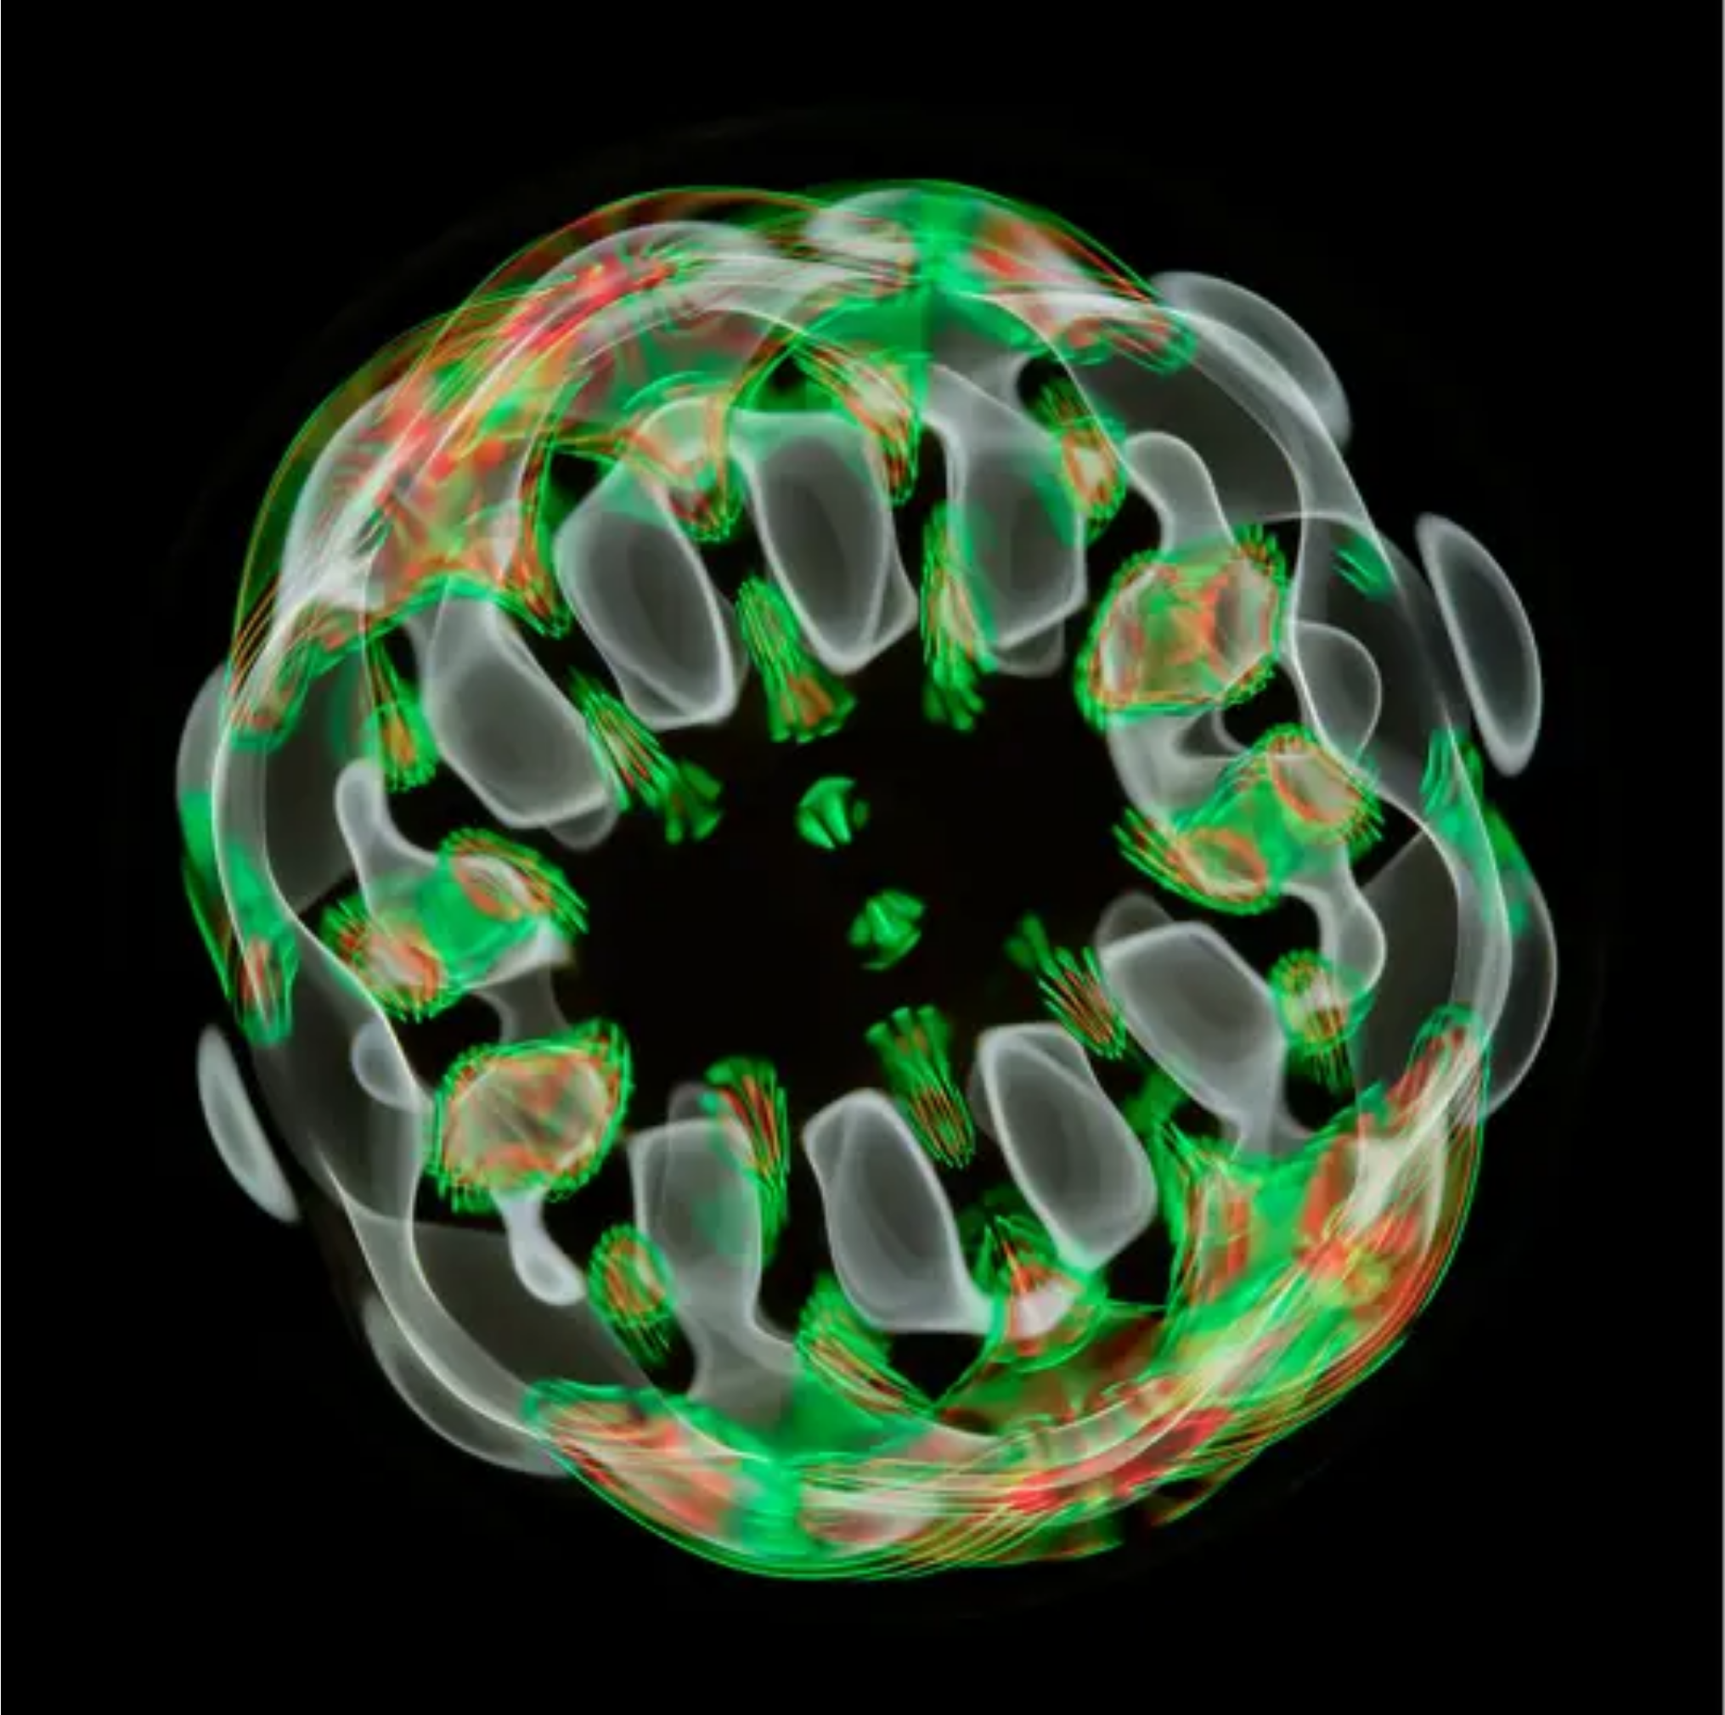






LIVE DEMO
Live Demo 1: Remarkable Coherence
"The demonstration will highlight how the Cymatics wave physically interacts with the fluid dynamics within the 'attention reservoir.'"
Key Demonstration Points
Cymatics Wave
Auditory sound patterns translated into visible wave forms
Fluid Dynamics
Physical displacement of fluid representing the 'attention reservoir'
System Integration
Proving sonification and fluid simulation systems are deeply intertwined
Sound Becomes a Physical Force
Cymatics wave directly interacting with fluid
Ephemeral Time: Seeing Sound, Hearing Time | 4/10

Slide 5












Criterion 2: Technical Sophistication
Professional-Grade Architecture
System Architecture
Decoupled & Scalable
IoC container ensures components are loosely coupled, allowing for easy extension without affecting the system.
Optimized Performance
Particle Factory and Object Pooling minimize garbage collection, ensuring smooth interactions with dynamic elements.
Audio
Fluid
ColorManager
Sound synthesis and processing
Dynamic fluid simulation
Visual color representation
Documented Intent
"Philosophical Comments" link implementation choices to the project's artistic vision, explaining *why* decisions were made.
Ephemeral Time: Seeing Sound, Hearing Time | 5/10

Slide 6










Code as Philosophy
"Good code explains how. Great code explains why."
Example: Philosophical Comment in Code
// PHILOSOPHY: Time is not a river we flow along, but a dimension we inhabit.
class
TimeExperience
{
// We don't measure time, we experience it through our interactions
Philosophical Comments
private
float
attentionReservoir;
public
void
interact
Integrated directly into the codebase
(
float
input) {
// Each interaction creates a ripple in the attention reservoir,
Link technical choices to artistic vision
// not unlike how our actions create ripples in time
attentionReservoir += input;
applyTurbulence(attentionReservoir);
}
Provide clarity on *why* decisions were made
private
void
applyTurbulence
(
float
force) {
// Turbulence is not just physical, but experiential
Beyond Syntax
// It represents the subjective feeling of time's passage
// rather than its objective measurement
Code is not just instructions for computers, but a medium for expressing philosophical ideas about time, perception, and experience.
}
}
Key Insight: The philosophical comment explains why the code works a certain way, not just how it works.
Links to Criterion 2
Ephemeral Time: Seeing Sound, Hearing Time | 6/10

Slide 7


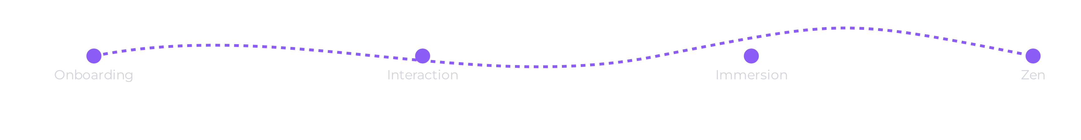










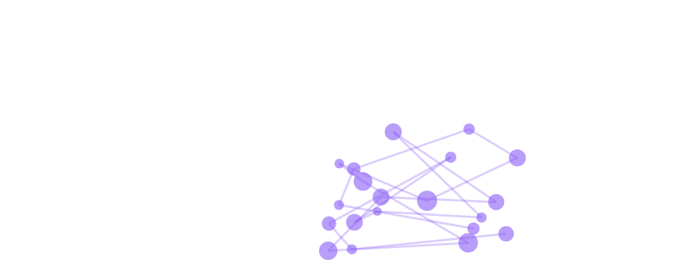






Criterion 3: User Experience - From Onboarding to Immersion
Intuitive Discovery
Polished Interaction
Total Immersion
A subtle "Disturb the flow..." cue guides first-time users, encouraging interaction without explicit instructions.
Turbulence created by user input exhibits inertia, providing a physical, "weighty" feel to the interaction.
A simple keypress ('Z') removes all on-screen UI elements, allowing for a purely sensory and uninterrupted experience.
Zen Mode (Z)
Disturb the flow...
Ephemeral Time: Seeing Sound, Hearing Time | 7/10

Slide 8



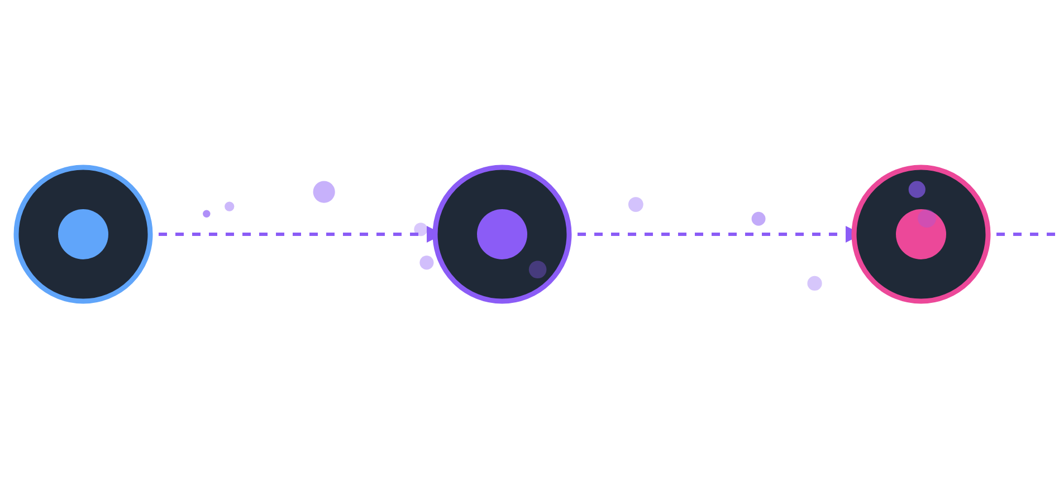







Live Demo 2: The Full Experience
Demo Sequence
Demonstration Visualization
1
Calm State
Project in default aesthetic state
2
Turbulence Creation
Interactive fluid dynamics
3
Chime Event
Cymatics interaction
Interactive Elements
Zen Mode
4
Zen Mode
Fluid dynamics respond to user input
Key press 'Z' removes UI elements
Total immersion
Ephemeral Time: Seeing Sound, Hearing Time | 8/10

Slide 9


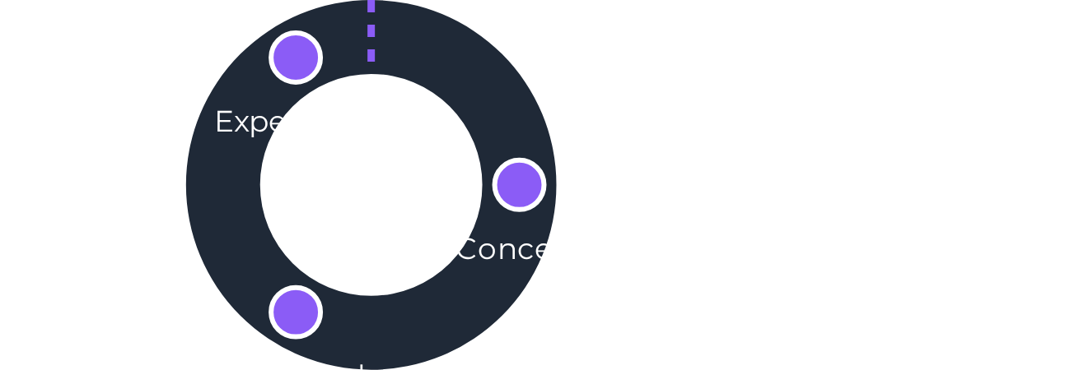







Conclusion: A New Way of Seeing Time
Achieved Goal
Project Achievement & Future Path
Successfully created a synesthetic meditation tool that redefines the perception of time beyond numerical constructs.
Demonstrated Excellence
Fulfilled all presentation criteria through a deeply coherent conceptual framework, robust technical sophistication, elegant user experience design, and meticulous code quality.
Future Vision
Conceptual
Technical
Experience
Coherent Framework
Robust Architecture
Elegant UX
The project's modular and scalable architecture allows for exciting future explorations, including integration with biometric data input and diverse physics models.
Ephemeral Time: Seeing Sound, Hearing Time | 9/10

Slide 10
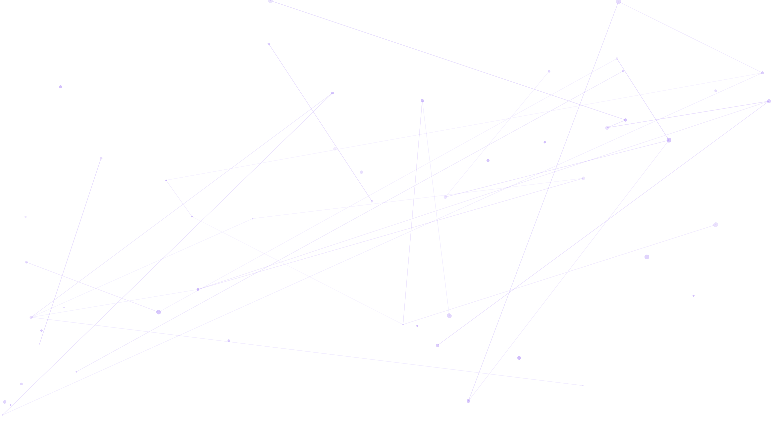














Thank You
Ephemeral Time: Seeing Sound, Hearing Time
10/10
Q&A
Contact & Project Information
How can we perceive time without numerical clocks?
What is synesthesia and how does it relate to time perception?
Thank You
Presenter
Email
[Name]
presenter@university.edu
How might we apply these concepts in our own work?
Department of Computer Graphics
For collaboration inquiries
Project Link
Future Events
github.com/user/ephemeral-time
[Dates]
Upcoming exhibitions
Open source implementation
All questions are welcome!

